Slide 1


NATIONAL TECHNICAL UNIVERSITY OF UKRAINE
«IGOR SIKORSKY
KYIV POLYTECHNIC INSTITUTE»
FACULTY OF APPLIED MATHEMATICS
DEPARTMENT OF COMPUTER SYSTEMS SOFTWARE
WEB-APPLICATION FOR E-COMMERCE ON CAR ACCESSORIES PLATFORM
Performed by: Mohamed Islam KHELILI
Supervisor: Associate Professor of DCSS, Ph.D., Assoc. Prof.
Dmytro NOVAK
Kyiv - 2023

Slide 2
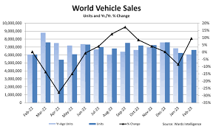
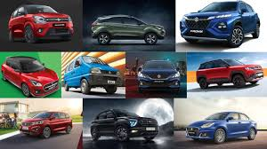
RELEVANCE
2/21

Slide 3
THE PURPOSE OF THE DIPLOMA PROJECT
The purpose of the diploma project is to develop a web-application for e-commerce on car Accessories platform, with the goal of providing businesses with a comprehensive online platform to showcase their products and enabling customers to engage in secure and efficient online shopping experiences. By creating an intuitive user interface, incorporating robust security measures, and implementing features such as product catalog management, streamlined checkout processes, the project seeks to enhance the overall car commerce ecosystem, fostering growth and innovation in the industry while catering to the evolving demands of businesses and customers.
3/21

Slide 4
TASKS OF THE DIPLOMA PROJECT
Analyze existing software solutions.
Determine the requirements for the software being developed.
Analyze and choose software implementation tools.
Develop a web-application for e-commerce on car Accessories platform according to the requirements.
Test the developed software and analyze the results.
Formulate ways of further development of the project .
4/21

Slide 5
CHALLENGES
Security: Keeping customer information and transactions secure is important to prevent data breaches and fraud.
Scalability: As the user base and transactions increase, the application should be able to handle the growing demand without slowing down.
User Experience: Designing an easy-to-use interface that is visually appealing and works well on different devices is crucial for customer satisfaction.
Integration: Connecting with payment gateways, shipping providers, and other systems requires smooth integration to ensure seamless operations.
Performance: Optimizing the application's speed and responsiveness is essential to avoid slow loading times and delays during transactions.
5/21

Slide 6

ANALOGUES
6/21

Slide 7
REQUIREMENTS FOR THE DEVELOPED SOFTWARE
Functional:
User information
Product Listings and Catalog Management
Shopping Cart and Order Management
Payment Integration
Inventory Management
7/21

Slide 8
REQUIREMENTS FOR THE DEVELOPED SOFTWARE
Non-functional:
User Reviews and Ratings
Security
Responsive Design
Analytics and Reporting
Scalability and Performance
8/21

Slide 9



SELECTION OF DEVELOPMENT TECHNOLOGIES
Backend
9/21

Slide 10




SELECTION OF DEVELOPMENT TECHNOLOGIES
Frontend
10/21

Slide 11
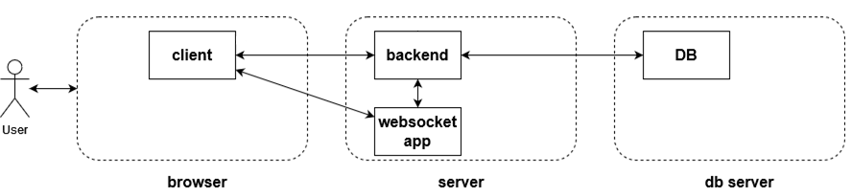
SOFTWARE ARCHITECTURE
11/21

Slide 12
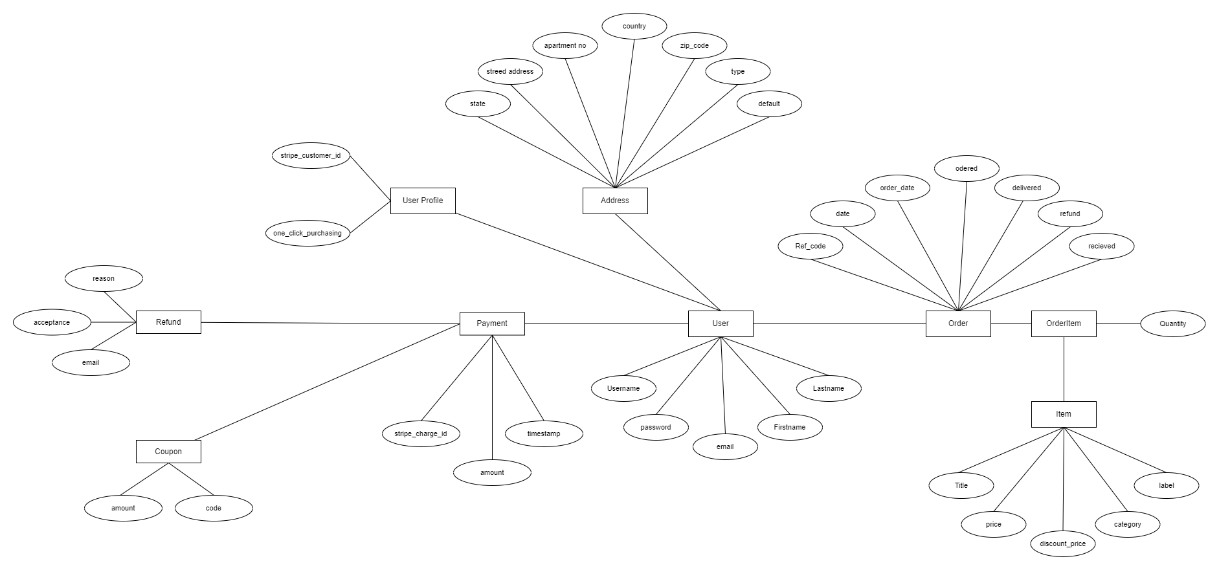
STRUCTURE OF ENTITY-RELATIONSHIP DIAGRAM
12/21

Slide 13
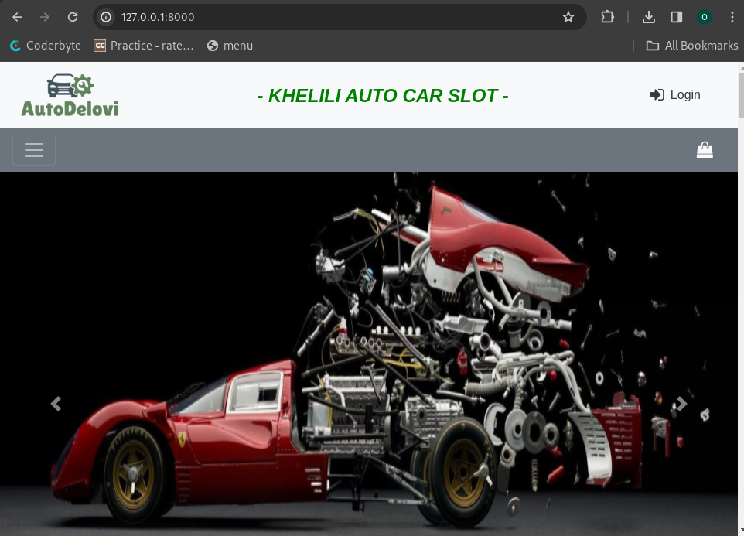
USER LANDING PAGE
Carousel
13/21

Slide 14
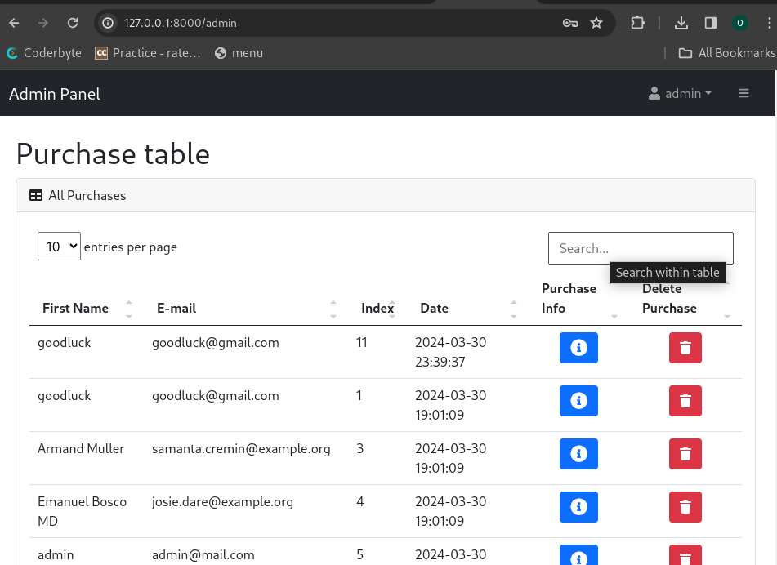
ADMIN SEARCH PAGE
Product cards
14/21

Slide 15
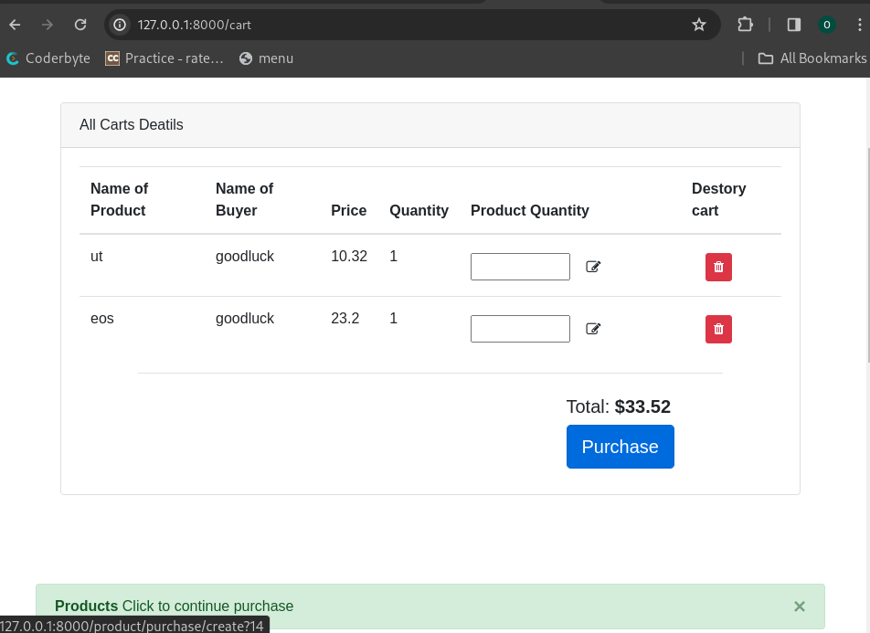
CHECKOUT FORM
User information (first name, last name , address ……..)
15/21

Slide 16
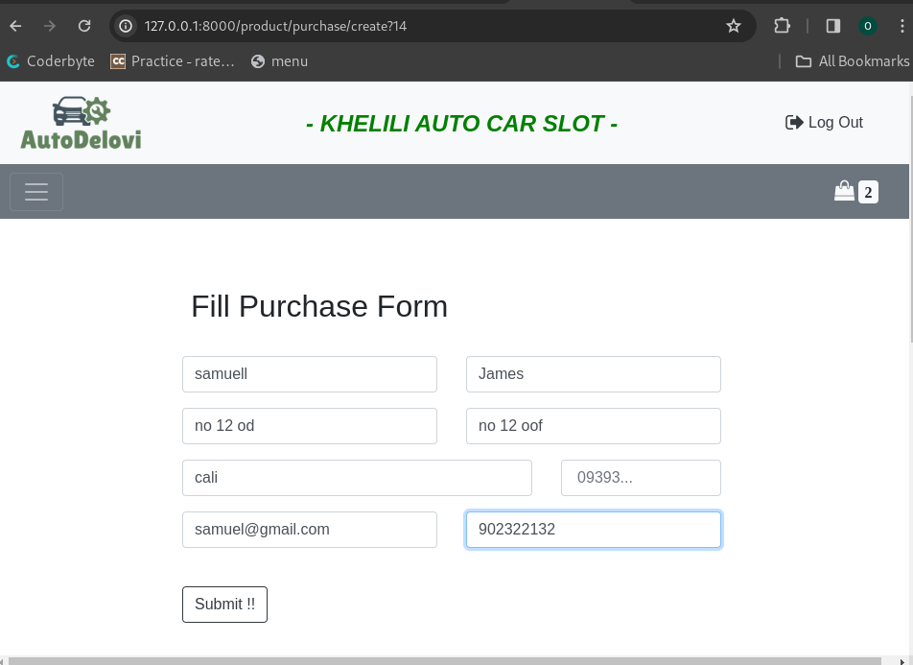
PURCHASE FORM
16/21

Slide 17
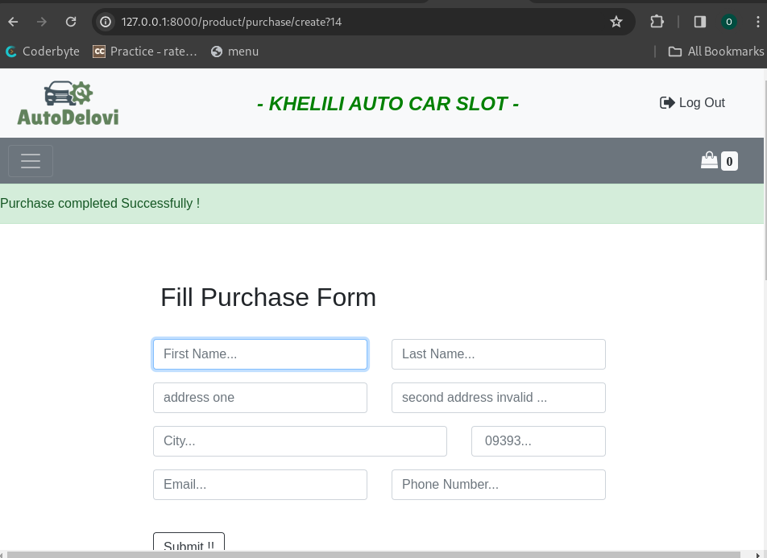
SUCCESSFUL PAYMENT PAGE
17/21

Slide 18
ADVANTAGES OF THE DEVELOPED SOFTWARE
The developed software offers several advantages over traditional e-commerce web-applications. One of the main advantages is the intuitive navigation and search features, which allow customers to quickly find the products they need and complete their purchases with minimal hassle.
The software also offers a seamless shopping experience across all devices, including desktops, laptops, tablets, and smartphones. Additionally, the secure payment processing ensures that customer information is protected at all times.
18/21

Slide 19
WAYS OF FURTHER DEVELOPMENT OF THE PROJECT
Improve the user interface
Add new features
Integrate commerce with social media
Enhance the search functionality
Implement a loyalty program
Optimize performance
19/21

Slide 20
CONCLUSIONS
The web application for the electronic commerce platform was created with a user-friendly interface that enables seamless online shopping experiences for customers and facilitates effective management of the platform for business owners. Throughout the project, a combination of HTML, CSS, and JavaScript was used for frontend development, while Python and SQLite were employed for backend implementation.
The choice of HTML, CSS, and JavaScript for frontend development proved to be effective in creating a user-friendly and visually appealing interface. These technologies allowed for the seamless integration of various design elements and the implementation of interactive features, enhancing the overall user experience.
On the backend, Laravel and SQLite were selected as the primary technologies. PHP provided a solid foundation for handling the application's business logic and server-side operations, while SQLite proved suitable for managing and storing the application's data.
The successful integration of these technologies resulted in a well-rounded web application for the electronic commerce platform. The application offers essential features such as product catalog management, shopping cart functionality, payment integration, and order processing. These features collectively contribute to a seamless and convenient online shopping experience for customers.
20/21

Slide 21
Thank you for attention!
21/21

